Slide 1
Getting Started with Office 365 Authentication and Authorization

Slide 2
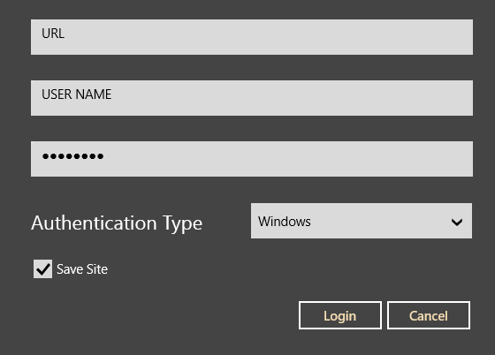
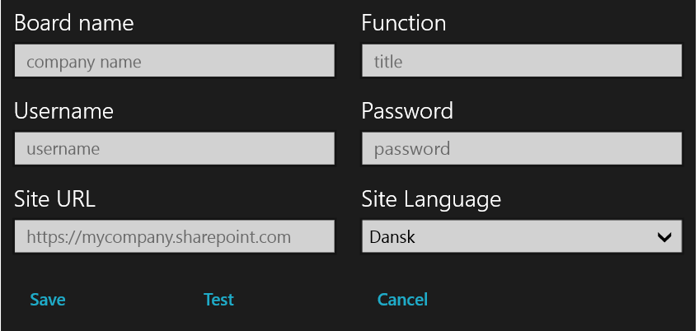
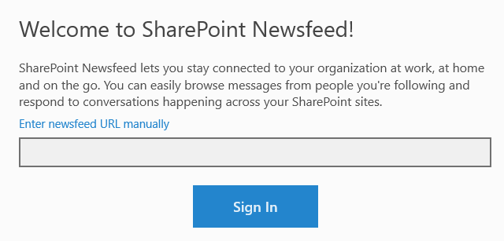
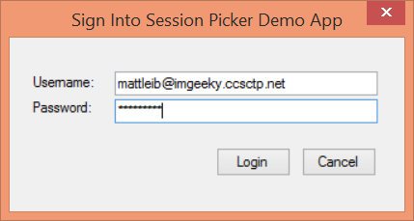
Office 365 Device Apps
Notes:
Prior to the release of the Office 365 APIs, device apps had to prompt users for credentials for the service, and in some cases the location of the resources.
Storing credentials is very risky, and a worst practice.

Slide 3
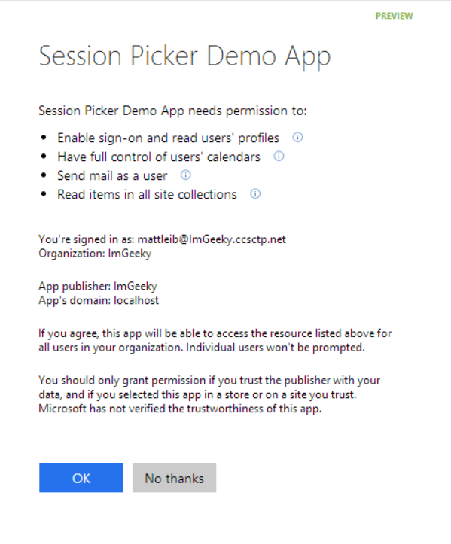
Azure AD OAuth in Office 365 Preview
Single auth flow for Office 365
Azure AD Graph, Exchange, SharePoint
Device apps and web sites
Admin and end-user consent
Secure protocol
OAuth 2.0
No capturing user credentials
Fine-grained access scopes
Supports MFA and federated user sign-in
Long-term access through refresh tokens
Notes:
With the Office 365 APIs, which leverage the Azure AD Oauth service, device apps no longer need to store user credentials.
Azure AD has implemented a “Common Consent” dialog, providing a consistent interface for permission grants.
Typically, OAuth is used to access a single resource. Common Consent is unique in that it can provide a token to Exchange Mail/Calendar/Contacts as well as SharePoint lists and files in OneDrive .

Slide 4
OAuth Basics and Authentication Flow

Slide 5
Authentication to Office 365 APIs using Resource Id
Azure AD Authorization
Endpoint
Azure AD Token
Endpoint
Native Application
Office 365 API
Request authorization code
Sign-in via browser pop-up
Return authorization code
Redeem authorization code and acquire access token for Office 365 resource
Return access token and refresh token
Call Office 365 API using the access token
Return Http Response
Notes:
** This slide has animations **
To facilitate the issuance of tokens for multiple resources, a different approach is required.
Instead of requesting an access token from the Authorization Endpoint, an authorization code is requested. The Resource Id for which a token is desired in included in the call to the Authorization Endpoint. The Authorization Endpoint will ensure the user is logged in, and will present the Common Consent dialog that lists the permissions requested by the application.
The authorization code is redeemed at the new Token Endpoint, which returns an access token and a refresh token. The token is issued for the resource identified in the authorization code request.
The access token is used to access the resource. The access token represents the user’s permissions to the resource. The application permission is granted during common consent.

Slide 6
App Registration & Authentication

Slide 7
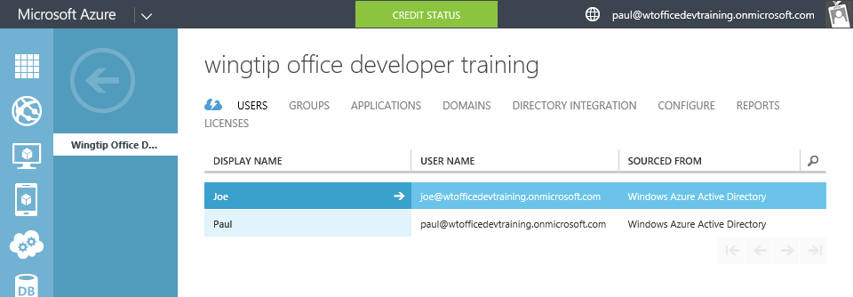
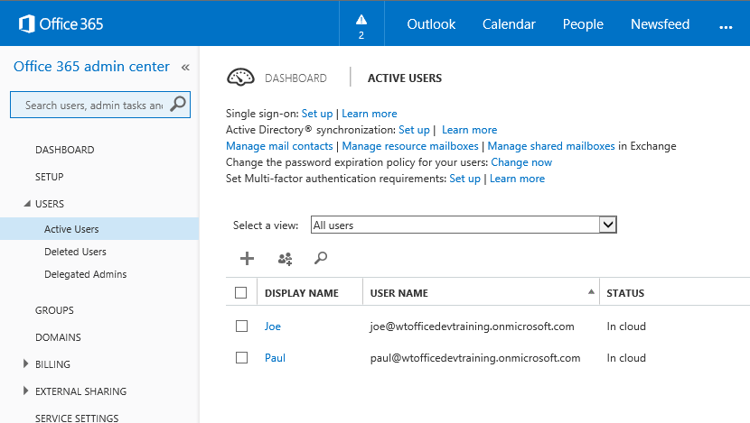
Azure Active Directory (Azure AD)
Included in Office 365 Subscription
Users & Groups managed in Office 365 Portal
Changes persisted in Azure AD
Notes:
Although an Azure AD is included with Office 365, accessing it via the Azure Management Portal requires a “sign-up.” However, there are no charges from Azure for using AD. (Charges will occur if other services are used.)

Slide 8
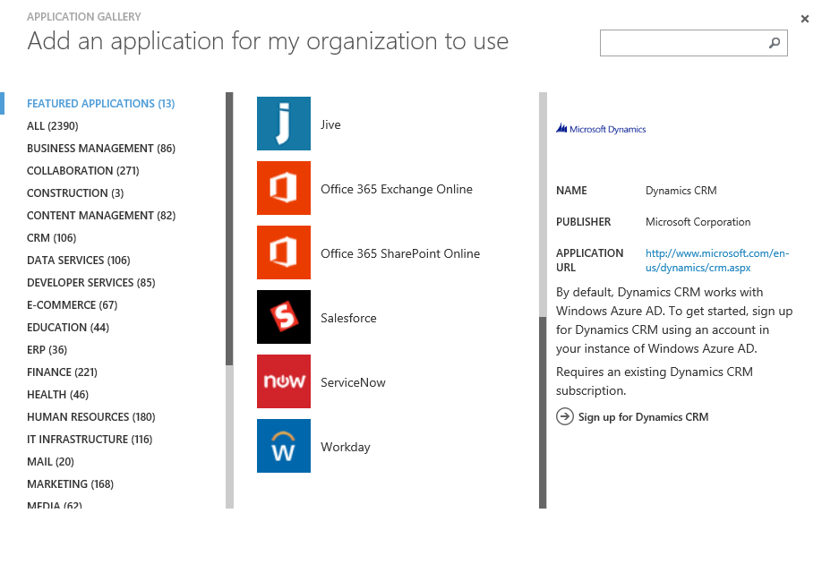
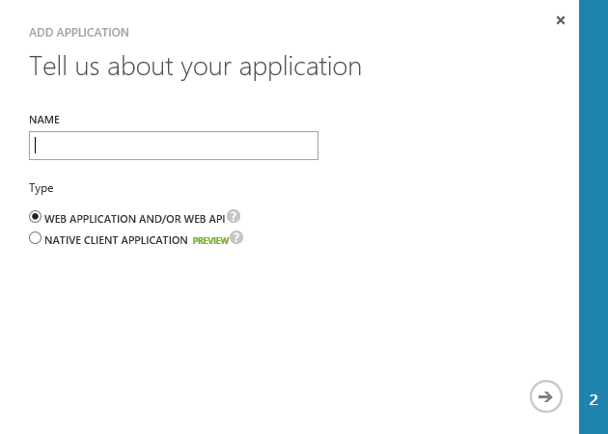
Application Registration
Application Types
Custom developed
Third-party, published in the gallery
Office 365 SharePoint, Exchange
Dynamics CRM
Thousands of others
Custom Applications
Web Application and/or WebAPI
Native Client

Slide 9
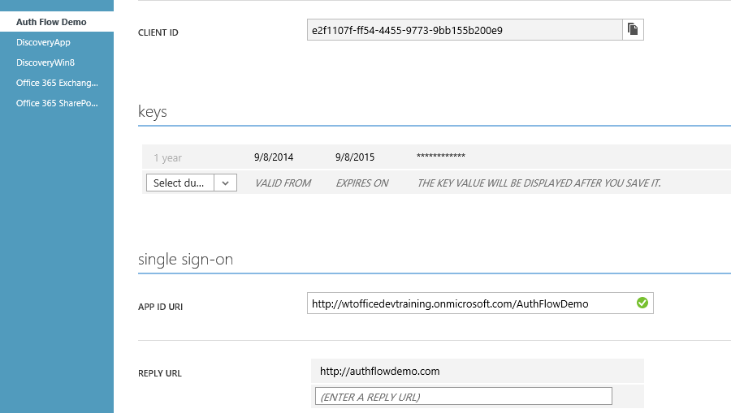
Custom Application Registration
Key information
Client ID
Keys (aka Client Secret)
Redirect /Sign-On URI

Slide 10
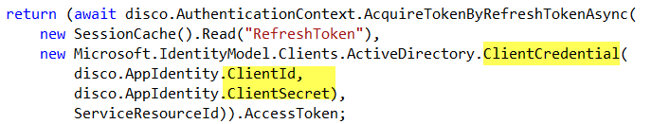
Application Authentication
App Authentication uses Client ID/Secret
Protect this information just as you would a user name / password
Notes:
In this snippet from Module 3653-4, notice the Client ID and Client Secret are used to create a credential object.

Slide 11
demo
OAUTH AUTHENTICATION FLOW

Slide 12
Troubleshooting

Slide 13
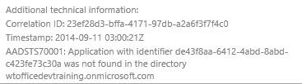
Troubleshooting Errors in Auth flow
Login Errors
Shown on web page
Fiddler
Shows response / request from apps running on local computer
Review Response as JSON
Authentication errors (invalid values)
{"error":"invalid_grant","error_description":"AADSTS70002: Error validating credentials. AADSTS50011: The reply address 'http://localhost:40298/Home/Discovery' is not valid.}

Slide 14
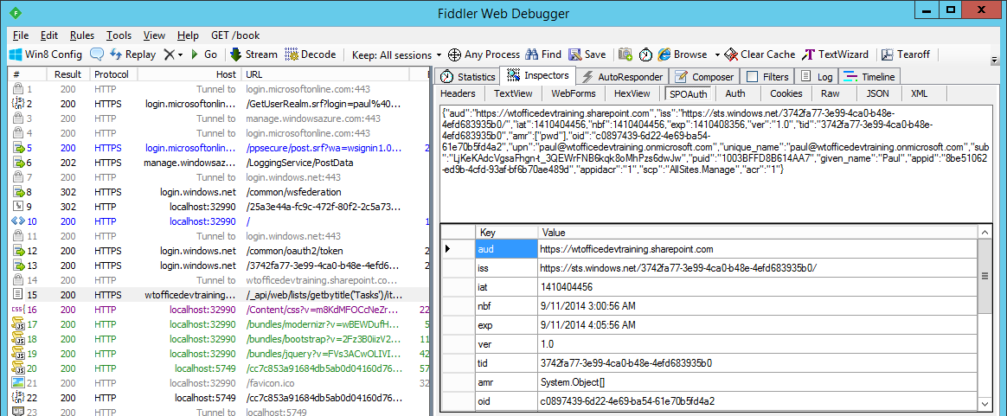
Troubleshooting Tokens
Fiddler
Extension to view SharePoint 2013 App Tokens
http://blogs.msdn.com/b/kaevans/archive/2013/08/25/creating-a-fiddler-extension-for-sharepoint-2013-app-tokens.aspx
Online
Paste token in web page
http://jwt.io/

Slide 15

Summary
Introduction
OAuth Basics & Authentication Flow
App Registration and Authentication
Office 365 Discovery Service

Slide 16

© 2014 Microsoft Corporation. All rights reserved. Microsoft, Windows, and other product names are or may be registered trademarks and/or trademarks in the U.S. and/or other countries.
The information herein is for informational purposes only and represents the current view of Microsoft Corporation as of the date of this presentation. Because Microsoft must respond to changing market conditions, it should not be interpreted to be a commitment on the part of Microsoft, and Microsoft cannot guarantee the accuracy of any information provided after the date of this presentation. MICROSOFT MAKES NO WARRANTIES, EXPRESS, IMPLIED OR STATUTORY, AS TO THE INFORMATION IN THIS PRESENTATION.

